Slide 1
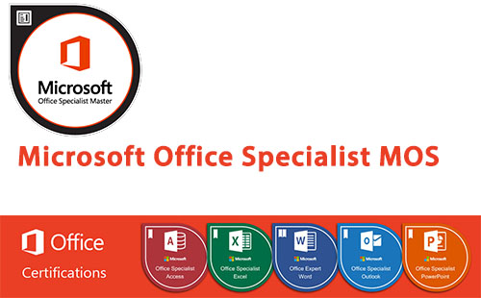
MICROSOFT OFFICE 2019 PROFESSIONAL

Slide 2
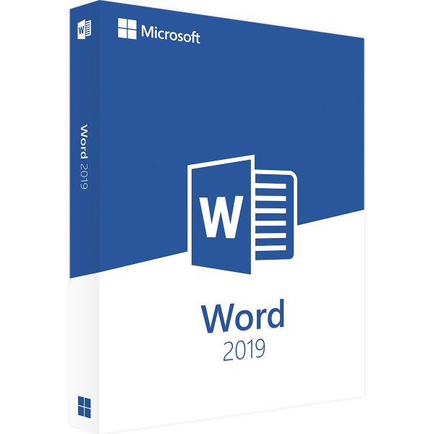
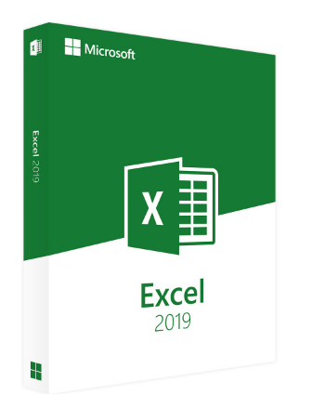



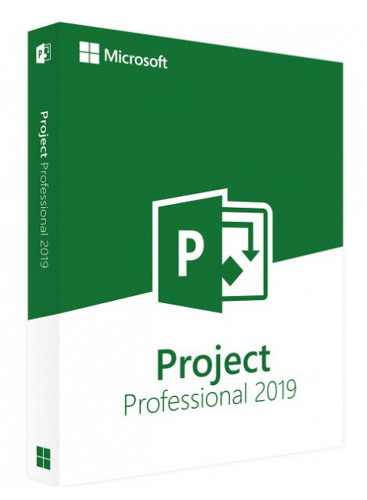
APPLICATIONS
Word |  | Excel |  | PowerPoint
Outlook |  | Access |  | Project

Slide 3
TOP FEATURES OF OFFICE 2019
Scalable Vector Graphics for Word, Excel, PowerPoint
Microsoft Translator in Word, Excel, PowerPoint
Create Math Equations with LaTeX equation in Word
Create smoother animations and movements with Morph in PowerPoint
New navigation feature called Zoom for PowerPoint
Use Surface Pen to navigate slides in PowerPoint
Exciting new functions in Excel
More powerful Inking functionality for all of Office 2019
Source: https://www.futurismtechnologies.com/blog/top-features-of-office-365/

Slide 4
VERSION & PRICE
Item | Price | Note
Office Home & Student | 86 USD
Office Home & Business | 345 USD
Office Professional | 586 USD

Slide 5
MICROSOFT WORD 2019 (MO-100)
Manage Documents
Insert and Format Text, Paragraph, and Sections
Manage Tables and Lists
Create and Manage References
Insert and Format Graphic elements
Manage Document Collaboration

Slide 6
MICROSOFT EXCEL 2019 (MO-200)
Manage Worksheets an Workboosk
Manage Data Cells and Ranges
Manage Tables and Table Data
Perform Operations by using Formulas and Functions
Manage Chart

Slide 7
Microsoft powerpoint 2019 (mo-300)
Manage Presentations
Manage Slides
Insert and Format Text, Shapes, and Images
Insert Tables, Charts, SmartArt, 3D Models, and Media
Apply Transitions and Animations

Slide 8

Thanks for listening

